Slide 1
BLOOD CONNECT
1 unit of donated blood can save up to 4 lives
Submitted By:

Slide 2
OBJECTIVE OF PROJECT
The main mission of blood connect is to meet the challenging requirement of blood during emergency.

Slide 3
PURPOSE OF PROJECT
Provides the stock of blood for various groups in the various blood banks
Provides online registration to people who are willing to donate blood
Gives the details of blood donation camps

Slide 4
STATEMENT OF THE PROBLEM
Scarcity of rare blood group
Unavailability of blood during emergency
Less awareness among people about blood donation
Deaths due to lack of blood during operations

Slide 5
Introduction to:
Html/CSS/JS/Bootstrap, Django, DB SQlite

Slide 6
Django
Django follows the MVT design pattern.
Model - The data you want to present, usually data from a database.
View - A request handler that returns the relevant template and content - based on the request from the user.
Template - A text file (like an HTML file) containing the layout of the web page, with logic on how to display the data.

Slide 7
HTML
Hyper text mark-up language.
It is used for designing purpose and for making static webpages.
Multiple tags are used.

Slide 8
DB SQlite
SQLite does not require a separate server process or system to operate (serverless).
SQLite comes with zero-configuration, which means no setup or administration needed.
A complete SQLite database is stored in a single cross-platform disk file.

Slide 9
Introduction to:
PROJECT

Slide 10
INTRODUCTION OF BLOOD CONNECT
This project is aimed to developing an online Blood Information.
In this Project we can collect an information about the donor, receiver and camp that are related to donating, receiving the blood.
cont…

Slide 11
Through this application any person who is interested in donating the blood can register himself and in the same way if any camp wants to register itself with this site that can also register.
Moreover if any general consumer wants to make request blood online he can also take the help of this site.
Admin is the main authority who can do addition, deletion, and modification if required.

Slide 12
MODULES OF PROJECT
User
Blood Donor
Blood Requisite
Camp
Admin

Slide 13
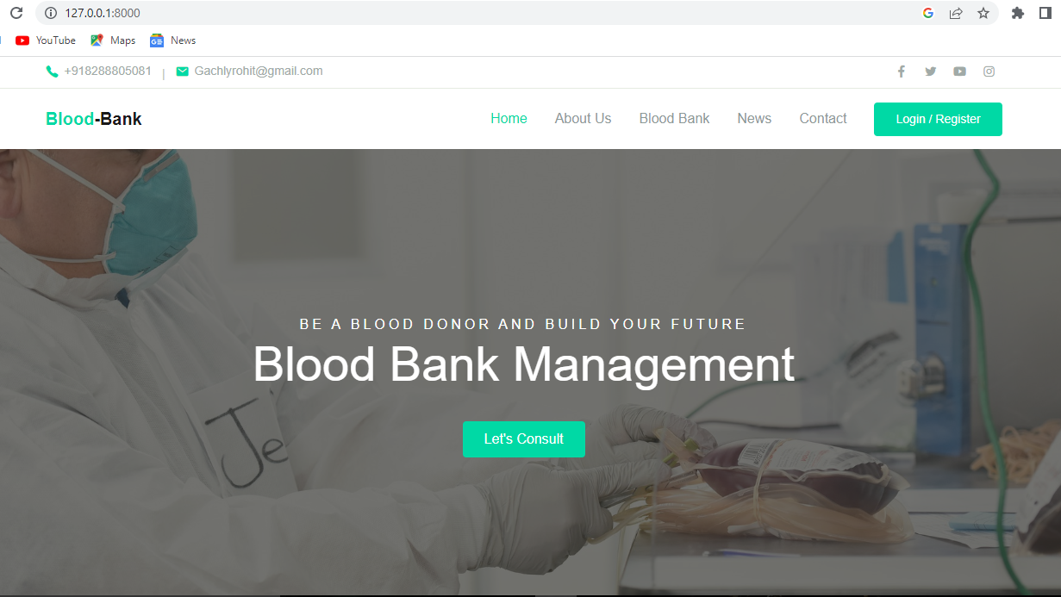
HOME PAGE

Slide 14
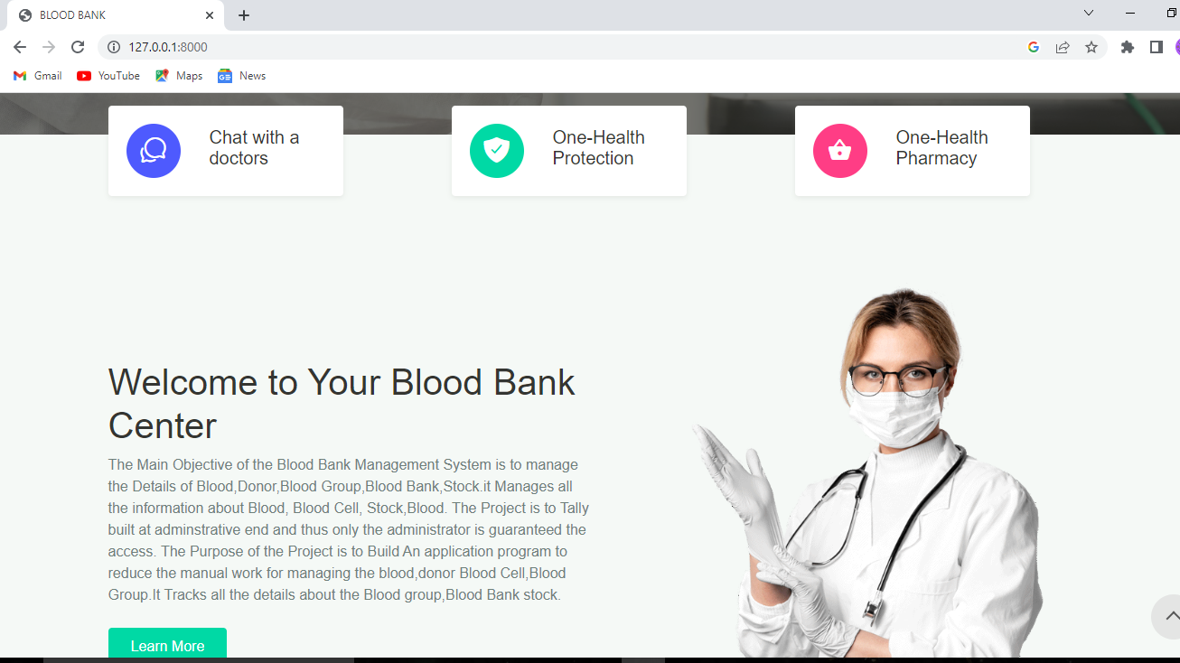

Slide 15
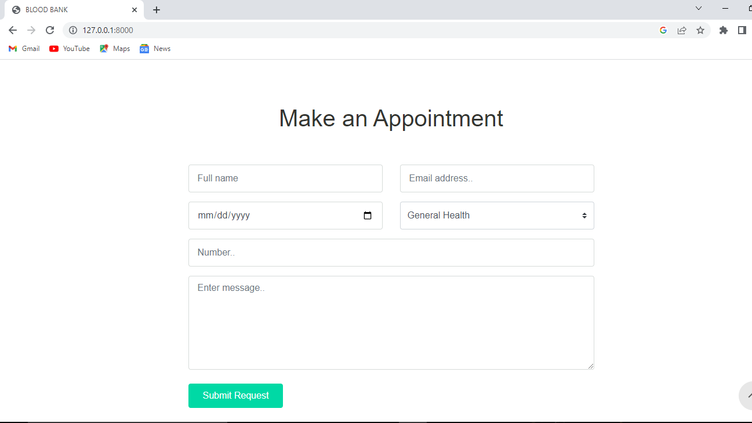

Slide 16
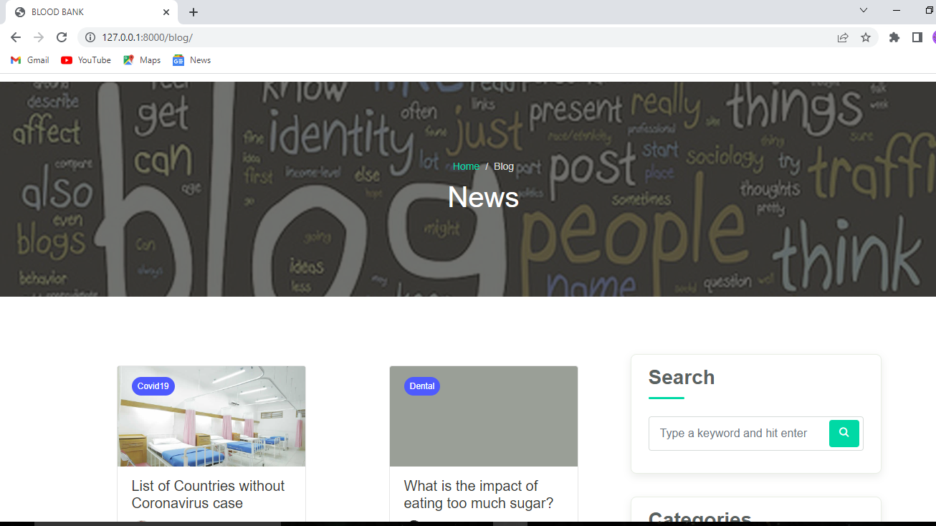

Slide 17
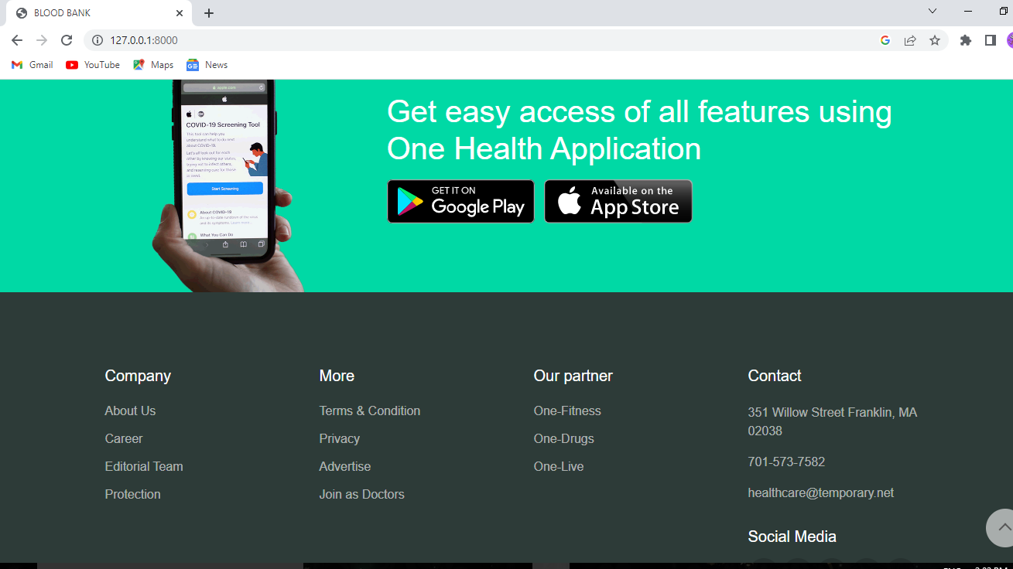

Slide 18
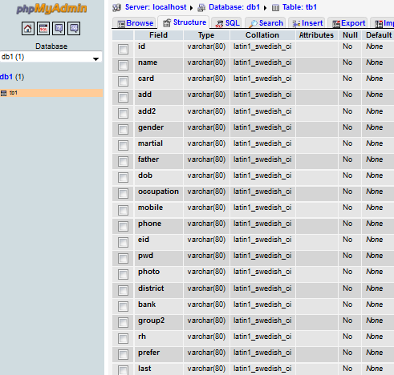
DATABASE TABLE

Slide 19
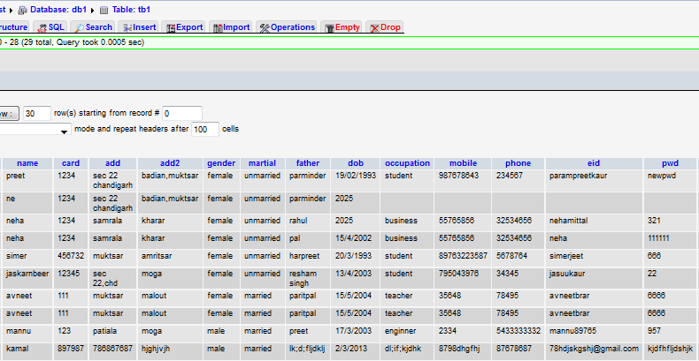
DATA ENTRIES

Slide 20
Many thanks to all of you who “give the gift of life” by donating blood

